Slide 1
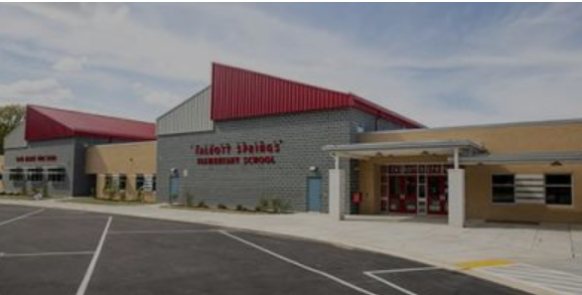
Welcome to
Talbott Springs Elementary School
Back to School Night
2022-2023
Principal, Nancy Thompson
Assistant Principal, Derek Lewis

Slide 2
VISION: Every student and staff member embraces diversity and possesses the skills, knowledge and confidence to positively influence the larger community.
MISSION: HCPSS ensures academic success and social-emotional well-being for each student in an inclusive and nurturing environment that closes opportunity gaps.
VALUE
ACHIEVE
EMPOWER
CONNECT
More information: www.hcpss.org/scta

Slide 4
TSES Core Values Equity Framework: Belonging
1. We celebrate the value that each individual brings to our school community.
2. We support and model positive learning behaviors in our community
3. We use resources that reflect our students' identities.

Slide 5
TSES Core Values Equity Framework:
Opportunity and Access
1. We create an environment that promotes flexible thinking.
2. We advocate for and provide enrichment opportunities to promote individual growth.
3. We provide a safe space where students, staff, and families are able to access resources (and opportunities) to ensure success.

Slide 6
HCPSS Equity Framework: Instructional Excellence
1. We are committed to the goal of successful learning for every student.
2. We encourage feedback, engage in reflection, and implement change for continuous instructional improvement.
3. We represent student identity and voice in instruction.

Slide 7
HCPSS Equity Framework: Engaged and Inspired Learners
1. We inspire our students, staff, and caregivers to take responsibility for their own learning.
2. We empower individuals to achieve their goals and celebrate each person's commitment to growth.
3. We partner with families and our community to enhance each student's learning experiences.

Slide 8
School and System News and Information
Email
Text
School news, HCPSS News,
emergency notices
Priority/emergency notices
HCPSS website
School website
www. tses.hcpss.org
www.hcpss.org
Systemwide news and information resource
School news, calendar, schedules, staff directory, additional information

Slide 9
Receiving Emails and Texts
Utilizing contact information submitted through the Family File, parents and guardians automatically receive emails from HCPSS and our school.
To comply with FCC & wireless carrier requirements, parents/guardians must opt in one time to receiving text message alerts. To confirm that you have opted in, text the word “YES” to 67587 from the cell phone number on file in HCPSS Connect Family File.
Unsubscribing to either an HCPSS or school email, will remove you from receiving all email messaging - including emergency notifications!
Please call the TSES front office if you believe you are not receiving emails and/or text messages.

Slide 10
HCPSS and TSES Social Media
TSES Twitter: @hcpss_tses
TSES PTA Facebook Page
HCPSS Twitter: www.Twitter.com/HCPSS
HCPSS Instagram: instagram.com/hocoschools
HCPSS Flickr: flickr.com/photos/hcpss
Superintendent Twitter: https://twitter.com/mjmsuper

Slide 11
Weekly System Emails
School system news and announcements
Upcoming events
Opportunities to share input on HCPSS policies and decisions

Slide 12
TSES Weekly Newsletters
Typically posted on Friday afternoons
TSES news, announcements and upcoming events.

Slide 13
TSES School Messenger and Alerts
Sending email address is no-reply@hcpss.org
Families with students at TSES automatically receive TSES School Messenger emails.
Emails are TSES information of a more immediate nature than a school wide weekly newsletter
Text alerts are urgent messages or reminders to families. Opt in through Family File found in HCPSS Connect.

Slide 14
HCPSS Mobile App
Free download on App Store:
iPhone
iPad
Android

Slide 15
School Closings/Delays
www.HCPSS.org
@hcpss
HCPSS News
Hotline
410-313-6666
HCPSS Status
status.hcpss.org

Slide 16
Inclement Weather
Details on HCPSS inclement weather processes are forthcoming!

Slide 17
Synergy Student
Information System
Canvas Learning Management System
Family File
www.hcpss.org/connect

Slide 18
Update Student Information
Parent contact information
Medical data and contacts
After-school transportation
Data privacy preferences
Athletic participation forms
www.hcpss.org/connect

Slide 19
HCPSS Connect: How to Get Help
Login Assistance:
Contact the school office
Guides and Resources:
https://hcpss.org/connect
Password Reset Guide:
https://hcpss.org/f/connect/synergy-parent-access.pdf

Slide 20
What Your Child Will Learn Guides
On Canvas via HCPSS Connect
Curriculum content overview for each
Grade (PreK – 5)
Subject area
www.hcpss.org/connect

Slide 21
Canvas: What to Expect
Course Homepage:
Overview
Student privacy information
Resources
Calendar dates/events
Assignments and Gradebook
Report Cards
Announcements
Direct Messaging (Inbox)
CANVAS
Canvas courses for preK-8 students have a more simplified interface than high school. When selecting a child, you will see the same layout as that child sees in Canvas.
Have Canvas Questions? Click the Canvas Student & Parent Orientation link under the Help icon on the Canvas homepage

Slide 22
Canvas: Navigation
Finding My Child’s Grades and Missed Assignments in Canvas
CANVAS
Canvas courses for preK-8 students have a more simplified interface than high school. When selecting a child, you will see the same layout as that child sees in Canvas.
Have Canvas Questions? Click the Canvas Student & Parent Orientation link under the Help icon on the Canvas homepage

Slide 23
Assessments at the Elementary Level
MCAP (Maryland Comprehensive Assessment Program) Grades 3, 4 and 5
MAP (or Measures of Academic Progress) Grades 1-5
CogAT (Cognitive Abilities Test) Grades 3 and 5
MISA (Maryland Integrated Science Assessment) Grade 5
ACCESS - (English Language Proficiency Assessments) Multilingual Learners Grades K-5
DIBELS (Dynamic Indicators of Basic Early Literacy Skills) Screener for Grades K-5

Slide 24
Mental Health – School-Based Supports
School Counselor: Mrs. Lauren Sansone
School Psychologist: Dr. Joel Roth
Alternative Education Teacher: Mrs. Lisa Green
BSAP Liaison: Mrs. Autumn Joiner
Hispanic Liaison: Ms. Arlette Garcia-Gill
Pupil Personnel Worker: Mrs. Catherine Chapman
Social Worker: Ms. Lesly Lemus
Family Involvement Contact: Mrs. Demika Johnson
More information: www.tses.hcpss.org

Slide 25
Mental Health Resources
Student Support Team at TSES
Network of Care
Community-based Wrap-around Services
Foreign-Born Support Services/Bilingual Support Services
Howard County Health Department Behavioral Health Navigation
Guide to Community Services in Howard County: https://www.acshoco.org/resources/guide-to-community-services/
More information: www.hcpss.org/supports/mental-health-wellness

Slide 26
Howard County Student Code of Conduct
The Howard County Public School System is committed to providing a safe, engaging and supportive learning environment where all policies are enforced fairly and consistently.

Slide 27
Howard County Student Code of Conduct
HCPSS policies and regulations emphasize instruction and rehabilitation rather than punishment and are designed to foster and reward appropriate behavior and keep students connected to school.

Slide 28
HCPSS Student Code of Conduct
We view the code of conduct as a team effort. There are responsibilities for staff, students, families, and our community. Let’s all do our part to make this year safe and successful for all!

Slide 29
Technology Devices
Current HCPSS device deployment implementation plan:
Pre-K: All students will receive an HCPSS-issued Chromebook to keep at home
K-5: Students will share devices that will be kept at school. Plan for the issuance and tracking of these Chromebooks is being created.
Student Personal Devices:
Students who have cell phones at the elementary school level are required to have those devices off and in backpacks throughout the school day (Policy 8080)
Students who wear technology devices are will be asked to remove them if the device becomes a distraction to the educational process.

Slide 30
Technology Devices
Please monitor your child’s use of their personal technology and HCPSS owned devices.
Student conduct as it relates to being on non approved sites or using technology to interrupt instruction, to harass, bully or harm another person will be addressed through the HCPSS Student Code of Conduct. Please reinforce the idea of ‘when in doubt, don’t send it out’.

Slide 31
A+ Student Card
Access HCLS eContent in the classroom, at home, or anywhere students need to do homework or research
Go to HCPSS.me and choose HC Library. Use your active directory login. Newly enrolled students will be active by October.

Slide 32
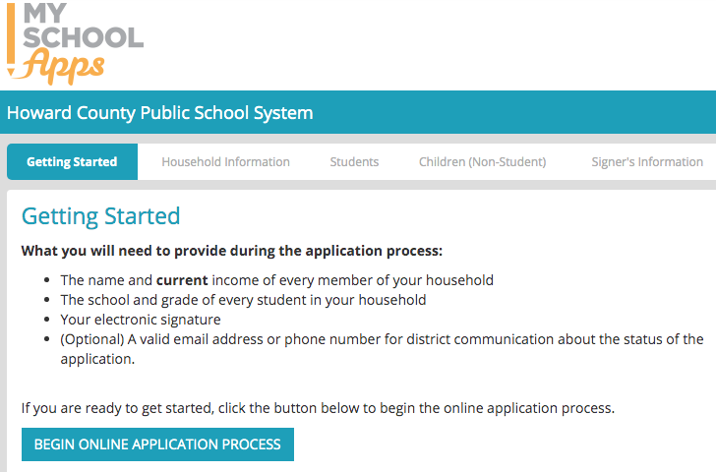
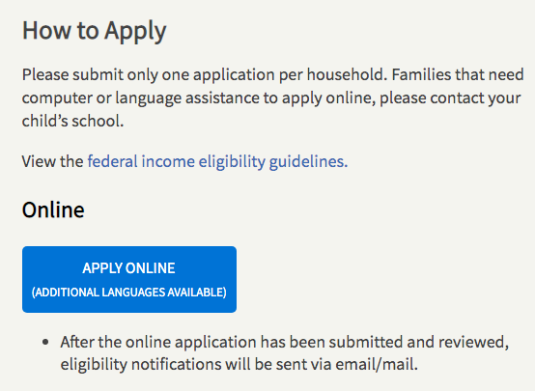
Free and Reduced-Price Meals (FARMs)
Step 1: Visit www.hcpss.org/farms/
Step 2: Click “Apply Online” to begin the online application process
HCPSS WEBSITE
APPLICATION

Slide 33
2022-2023 Student Meals
REMINDER! The 2022-2023 school year will return to pre-COVID student meal procedures
The federal government has not extended waivers allowing free meals for all students. Students whose families do not qualify for free or reduced lunch will be required to pay full price.
Daily Meal Prices
Student Breakfast Breakfast – $2.00 Reduced Price Breakfast – $0.00 Free Breakfast – $0.00 | Student Lunch Elementary School Lunch – $2.80 Middle/High School Lunch – $3.30 Reduced Price Lunch – $0.00 Free Lunch – $0.00 Milk (1/2 pint) – $0.50

Slide 34
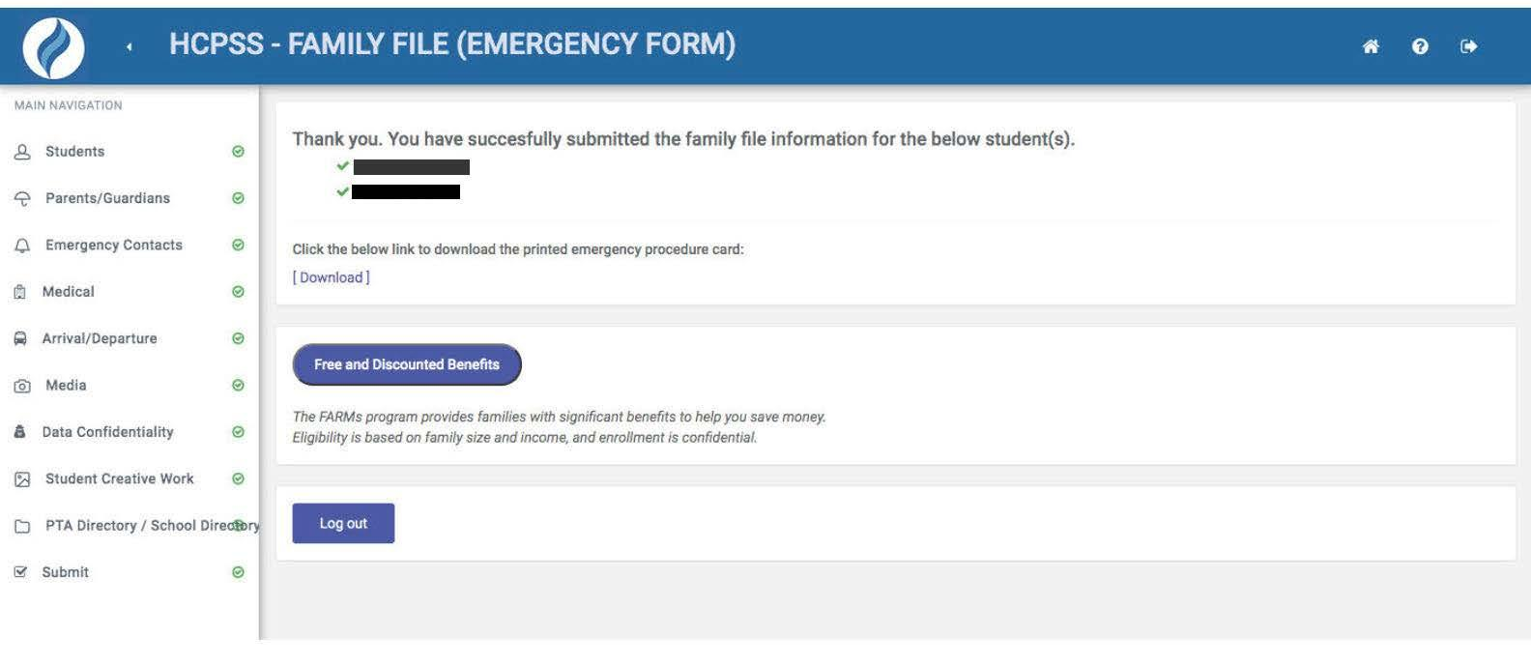
Free and Reduced-Price Meals (FARMs)
Qualifying families can receive free or reduced-cost:
School meals
Health insurance
HCC tuition
SAT, ACT and AP exam fees
Camps, sports, child care
Many other benefits

Slide 35
Free and Reduce-Price Meals (FARMs)
Free and Reduced-Price Meals (FARMS)
How does filling out your FARMs form impact
Title I eligibility?
Complete the form by October 31
Determines Title I status

Slide 36
Interactive School Menus on Nutrislice
Food descriptions
Nutrition and allergens
Carb counts
Pre-payment links
FARMS application link
Breakfast and lunch menus
http://hcpss.nutrislice.com
Free iPhone or iOS app
HCPSS Mobile App

Slide 37
Title I Schools
Schoolwide enhanced programs, services and enrichment
Available to all students in our school
Family involvement for all families

Slide 38
School-Based Wellness Centers Program
Providing in-school health care for students to limit their missed classroom time and parents’ time away from other responsibilities.
While in school, students can be treated for:
On-site provider services:
Minor illnesses and injuries
Physical exams (if unable to receive from child’s medical provider)
Behavioral health screening
Immunizations (if eligible)
Telemedicine services (when on-site provider is not available):
Ear infections
Asthma flare-ups
Strep throat
Pink eye
Other minor illnesses and injuries
For More Information, please contact the School-Based Wellness Center Program at HowardSBWC@howardcountymd.gov

Slide 39
SCHOOL-BASED WELLNESS CENTERS PROGRAM
The School-Based Wellness Centers offer health services for all students regardless of health insurance or family income.
Program physicians and nurse practitioners provide health services only during the school day and do not replace students’ regular health providers.
School-Based Wellness Centers will bill Medical Assistance only for in-person visits. There are NO copays or bills for uncovered charges.
Telemedicine visits are not billed unless a student sees their own medical provider via telemedicine. Klebanow & Associates and Columbia Medical Practice use the Program’s virtual platform to see their own patients and bill these visits the same as office visits. If your child has a different medical provider, your child will see a Columbia Medical Practice provider but you will NOT be charged any co-pays or fees. If your child has health insurance and the insurer only pays part of the bill, you will NOT be responsible for any unpaid balance.
For more information on the program, please visit the Howard County Health Department website:
https://www.howardcountymd.gov/health/school-based-wellness-centers
Or contact the program at HowardSBWC@howardcountymd.gov

Slide 40
SCHOOL-BASED WELLNESS CENTERS PROGRAM
TSES Health Room Staff:
Ms. Lindsey Squillario, RN
Ms. Antricka Byrd, CNA
School Based Wellness Centers Program (Howard County Health Department)
Ms. Ambyr Klink, Nurse Practitioner
Ms.Alicia Fleischer, Direct Care Associate
For more information on the program, please visit the Howard County Health Department website:
https://www.howardcountymd.gov/health/school-based-wellness-centers
Or contact the program at HowardSBWC@howardcountymd.gov

Slide 41
LGBTQIA+ Youth
New web page: https://www.hcpss.org/supports/lgbtqia-youth/
Optional pronoun settings: https://news.hcpss.org/news-posts/2021/04/ optional-pronoun-settings-in-canvas/
Diversity, Equity and Inclusion information:
https://www.hcpss.org/diversity/

Slide 42
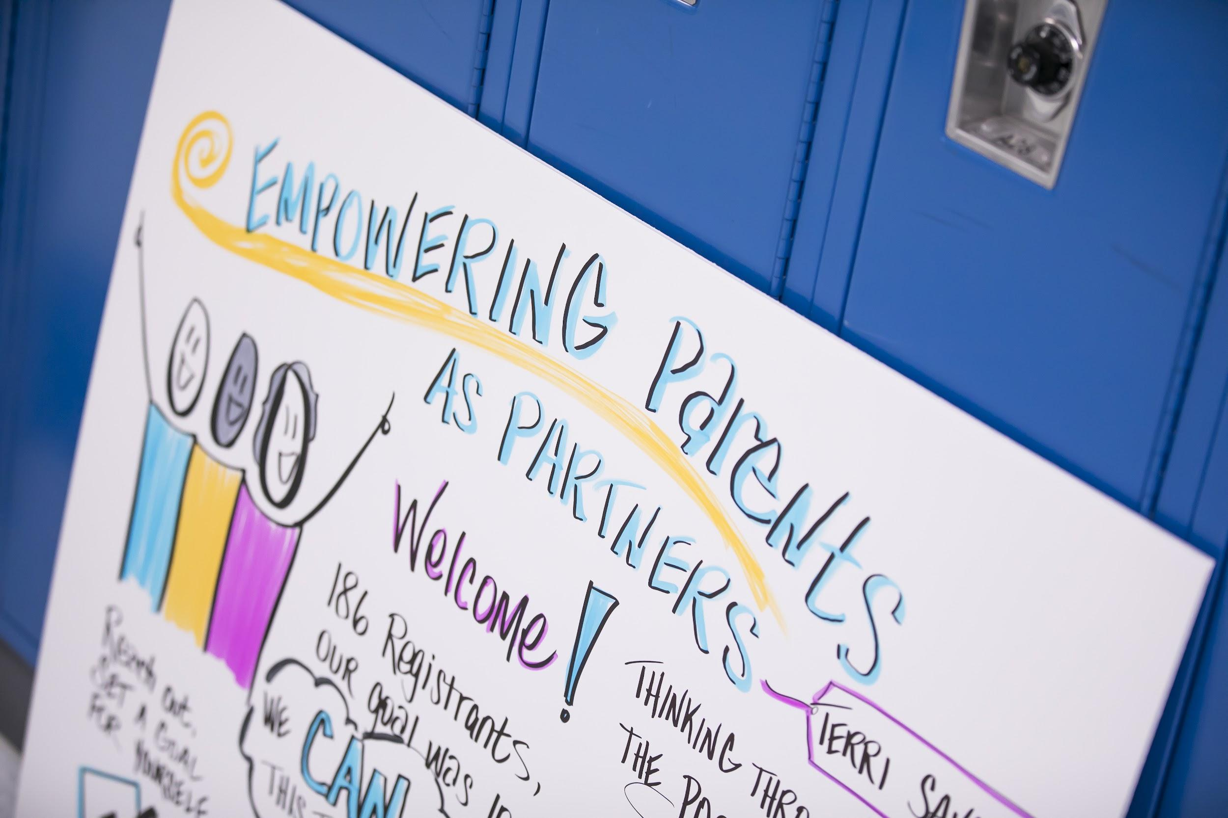
Community News and Programs
Find activities and resources for students and families offered by many community non-profits and agencies
Search by keyword, ages or topic
Lini is provided in the TSES Friday Newsletter.
community-programs.hcpss.org

Slide 43
Thank you for joining us!
Classroom teachers will upload grade level presentations to Canvas.
We are looking forward to a wonderful school year!

